Slide 1
Prerequisites
Windows
Windows + Ubuntu
Macbook

Slide 2
Motive
To practice day to day exercises
Virtual machines required to setup tools
Virtualbox used mostly for vm creation
Virtualbox can be installed on Win, Ubuntu & MacOS
Manual setup of VM is time consuming
Vagrant + Virtualbox for vm automations

Slide 3
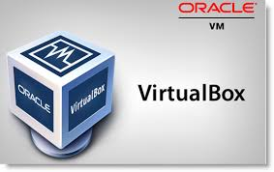
Virtualbox
A VirtualBox or VB is a software virtualization package that installs on an operating system as an application. VirtualBox allows additional operating systems to be installed on it, as a Guest OS, and run in a virtual environment.

Slide 4
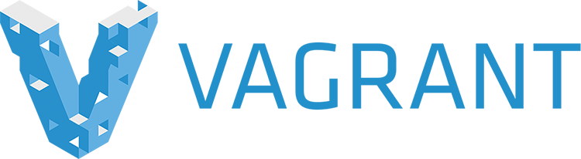
Vagrant
The command line utility for managing the lifecycle of virtual machines
Uses hypervisors like Virtualbox to create VM

Slide 5
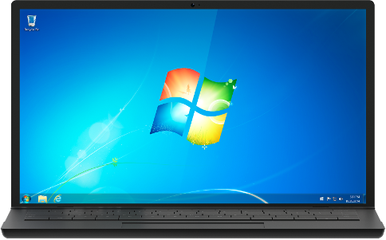
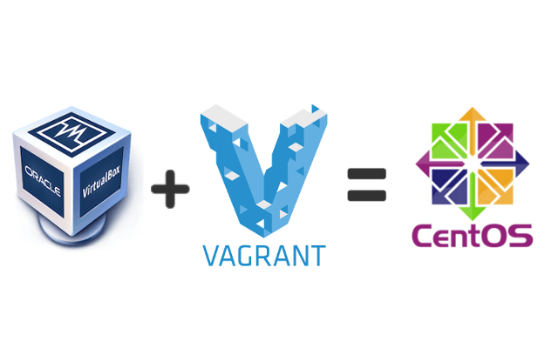
Windows
Host OS – Windows
List of softwares – Vagrant, Virtualbox

Slide 6
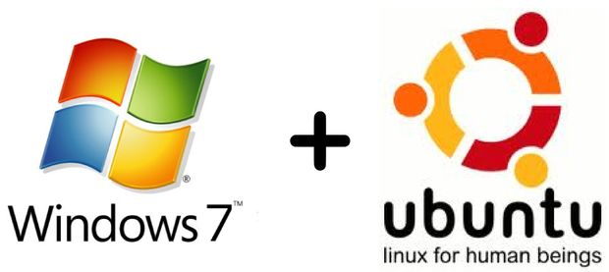
Dual boot
Host OS -- Windows + Ubuntu
Ubuntu on the system and not as virtual machine
Softwares for dual boot
Ubuntu 16.04 ISO
Rufus for bootable pen drive
List of softwares on Ubuntu – Vagrant, Virtualbox

Slide 7
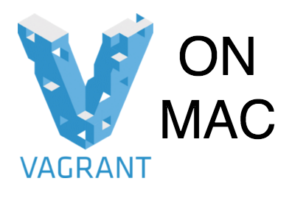
Macbook
Host OS – MacOS
List of softwares – Vagrant, Virtualbox

Slide 8
Comparision
Windows
Not so good performance of VM
Cannot install most of devops tools on Host OS
Ubuntu
Very good performace of VM
Can install ansible, chef, puppet on Host OS
Mac OS
Very good performace of VM
Can install most of tools like ansible, chef, puppet on Host OS

